Slide 1


江苏壹贰叁肆汽车科技有限公司
JIANGSU ONE TWO THREE FOUR AUTOMOBILE TECHNOLOGY CO.,LTD

Slide 2
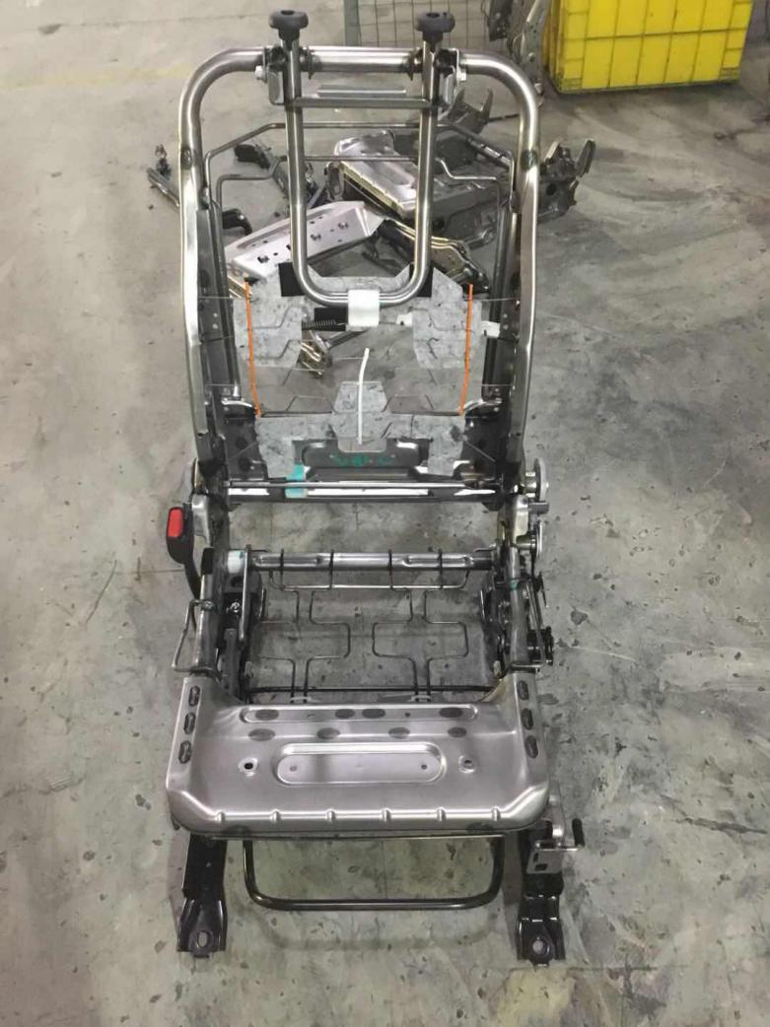
江苏壹贰叁肆汽车科技有限公司
JIANGSU ONE TWO THREE FOUR AUTOMOBILE TECHNOLOGY CO.,LTD
1、拆卸座椅 Tearing down the seat
1.对座椅整体外观拍照 塑料护板卡钉安装位置 螺栓装配孔位等细节进行拍照记录
Taking photos about seats’details of overall appearance ,thelocation of plastic sheeting cardin and pilot hole.
2.对拆卸好的皮套外观件归置在专用区域 以免划伤 皮套弄脏。
In order to scratch and pollute the leather sheath ,we should put them on speciliza area.
3.测量滑轨安装支脚的间距，做好记录
Figuring out installment space of stand bar of slide way and make record.
4.确定改装方案后拆除滑轨手动解锁、锁止机构
Tearing town organization of manual deblocking and look after making sure the modification plan
Tearing down the skeleton like this

Slide 3
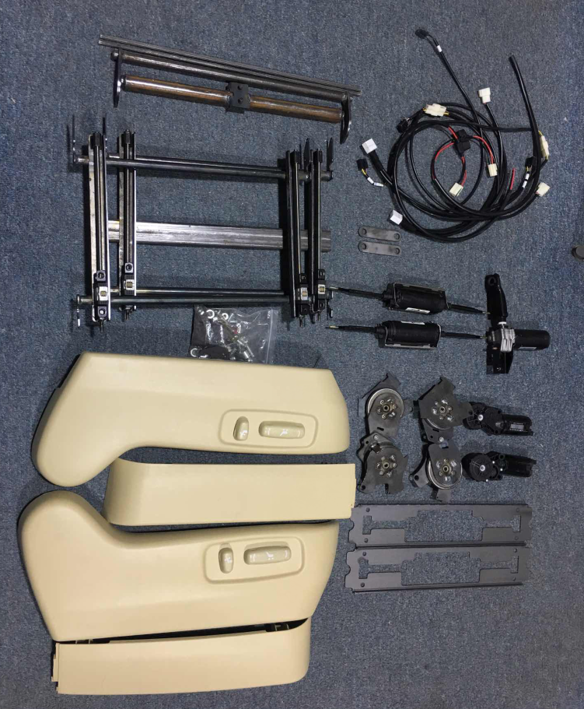
江苏壹贰叁肆汽车科技有限公司
JIANGSU ONE TWO THREE FOUR AUTOMOBILE TECHNOLOGY CO.,LTD
2、检查所收到配件是否齐全 Checking whether the body kits are integrity that received
滑移机构electrical equipment organization of slip
开关面板线束Switch panel wire harness
靠背调角器组件The back of the rector component

Slide 4
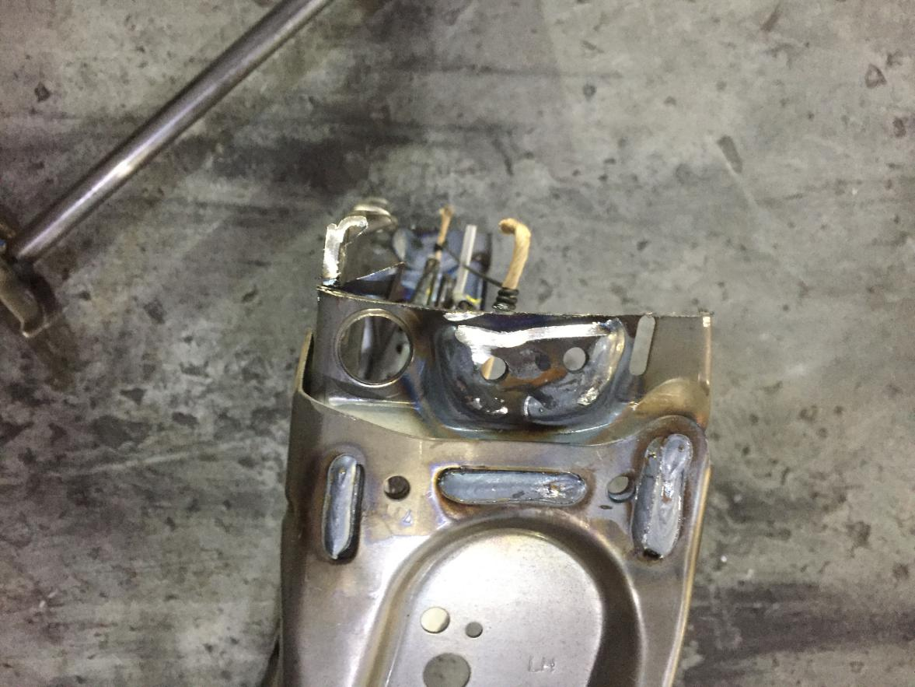
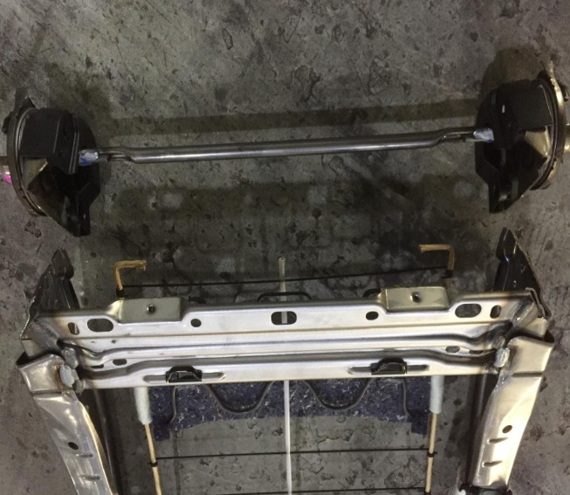
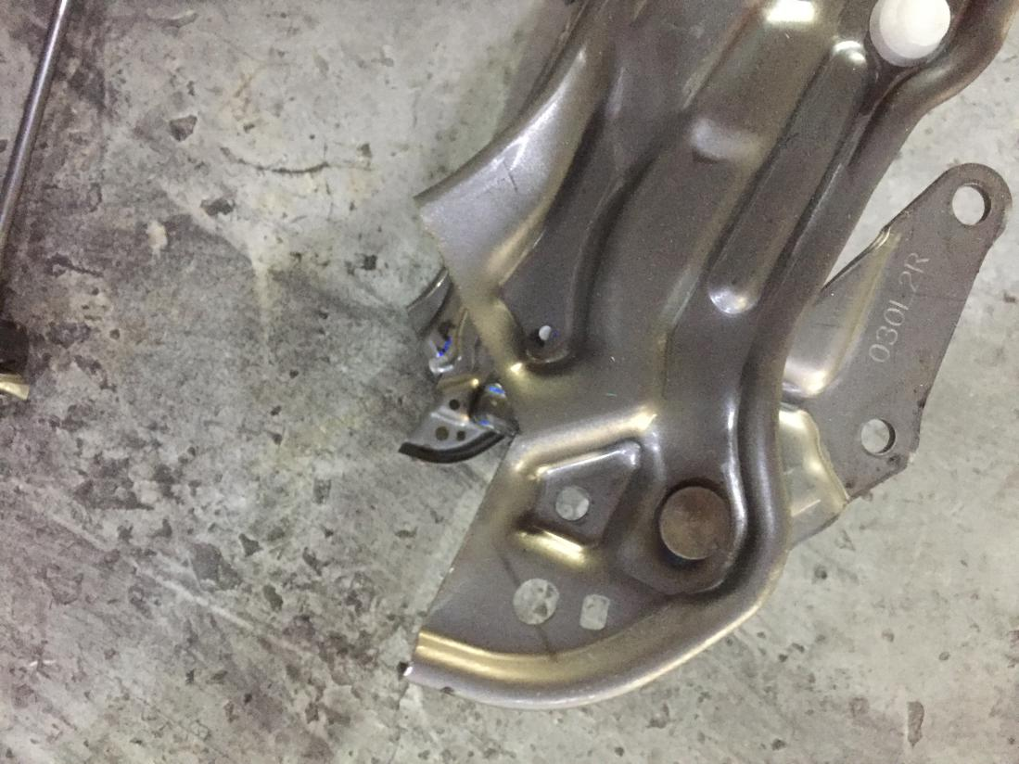
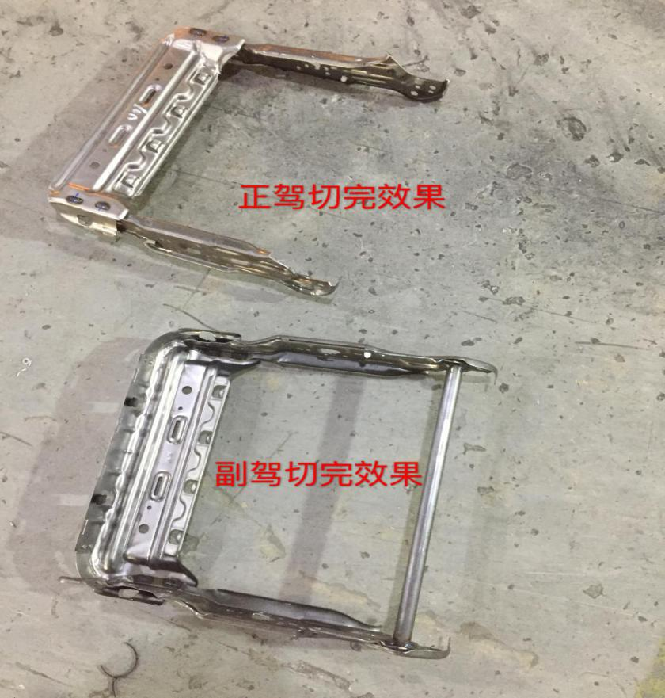
江苏壹贰叁肆汽车科技有限公司
JIANGSU ONE TWO THREE FOUR AUTOMOBILE TECHNOLOGY CO.,LTD
3、靠背切割, 底座切割 The cut of back and base as shown in the picture one
Main driving position
Deputy driving position

Slide 5
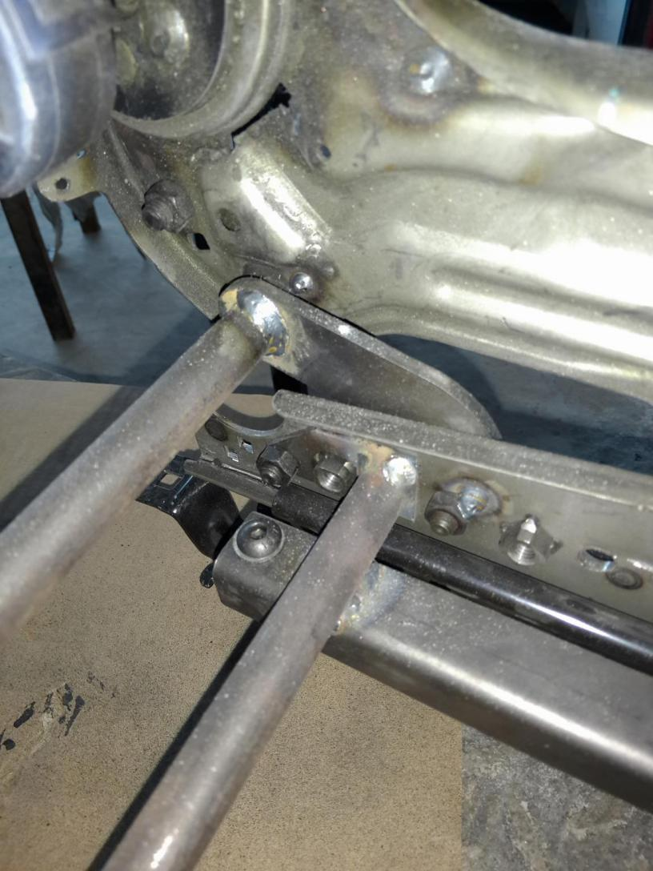
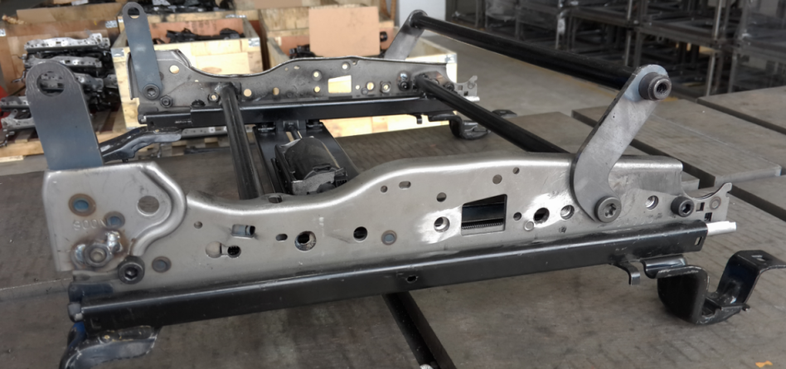
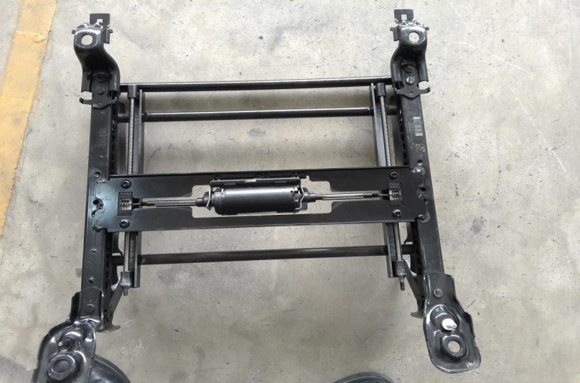
江苏壹贰叁肆汽车科技有限公司
JIANGSU ONE TWO THREE FOUR AUTOMOBILE TECHNOLOGY CO.,LTD
4、磨滑轨 焊支架 Grinding slide way Welding stents

Slide 6
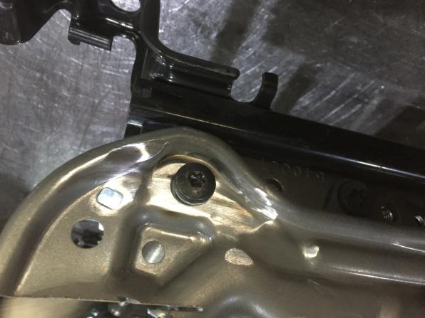
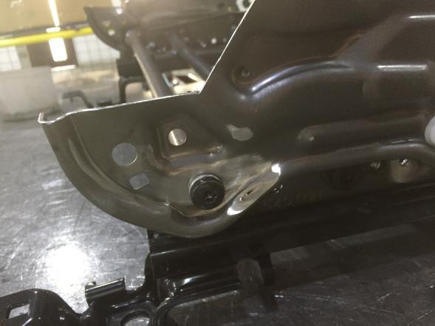
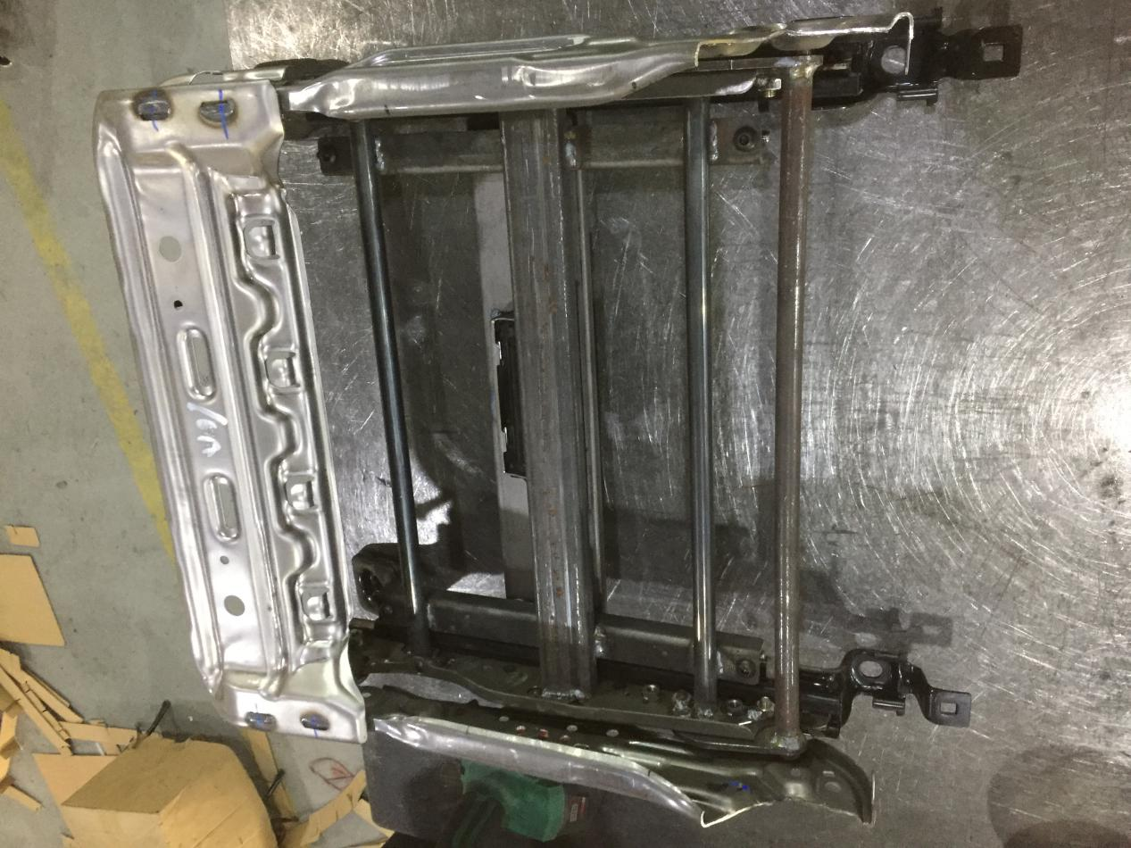
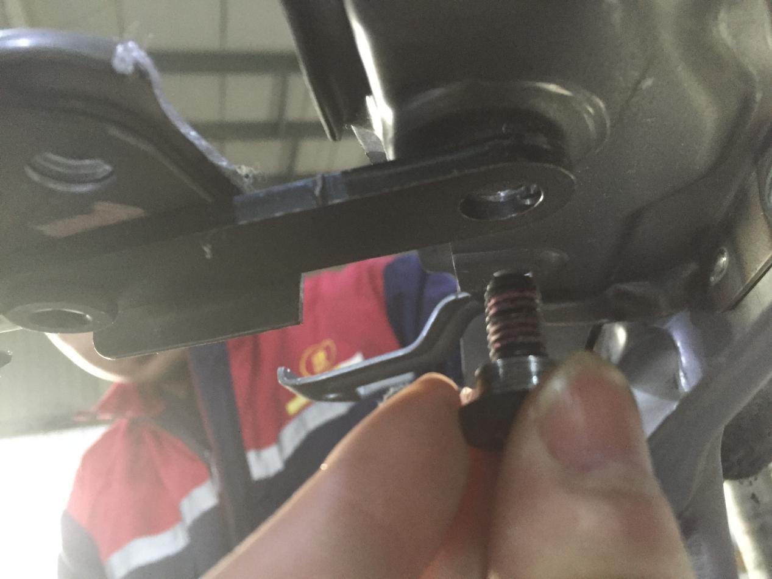
江苏壹贰叁肆汽车科技有限公司
JIANGSU ONE TWO THREE FOUR AUTOMOBILE TECHNOLOGY CO.,LTD
5、组装机构,按装螺丝 Fix assembly, Fix screw

Slide 7
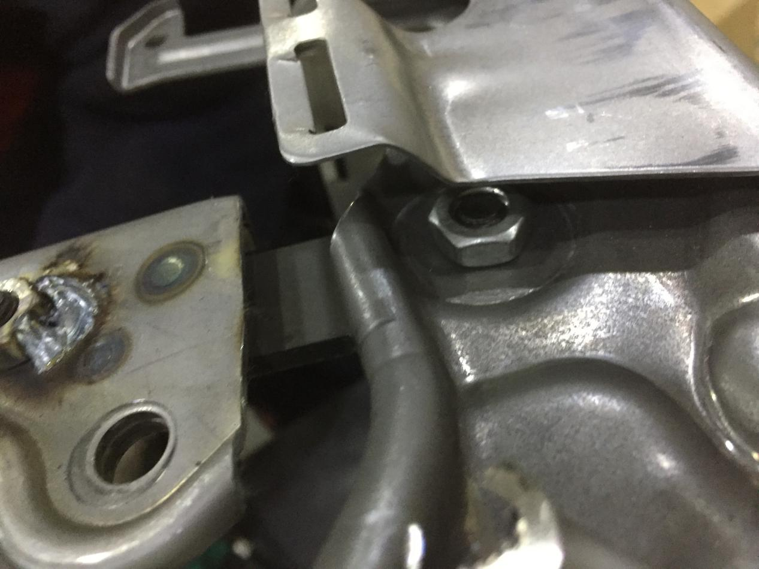
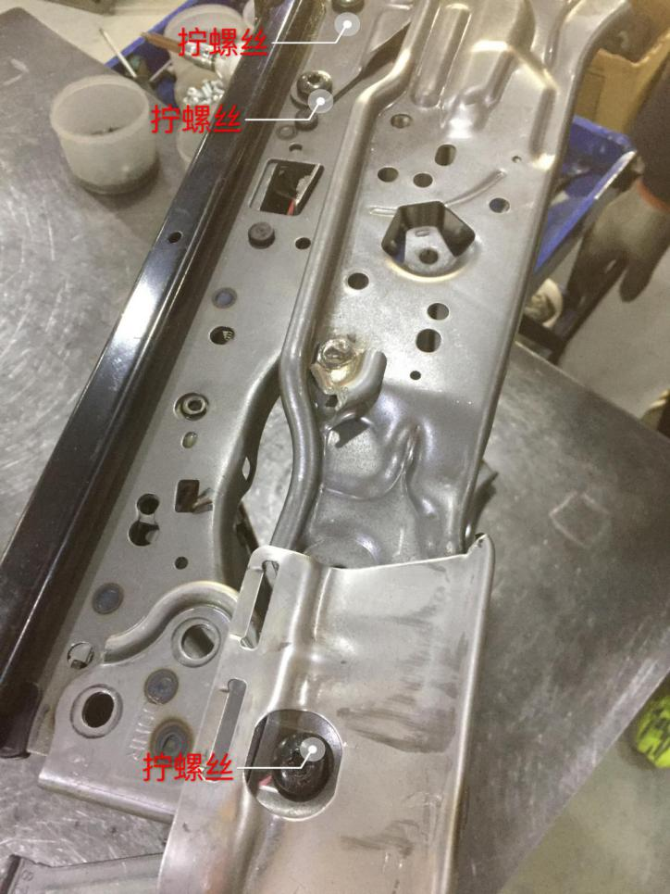
江苏壹贰叁肆汽车科技有限公司
JIANGSU ONE TWO THREE FOUR AUTOMOBILE TECHNOLOGY CO.,LTD
5、组装机构,按装螺丝 Fix assembly, Fix screw

Slide 8
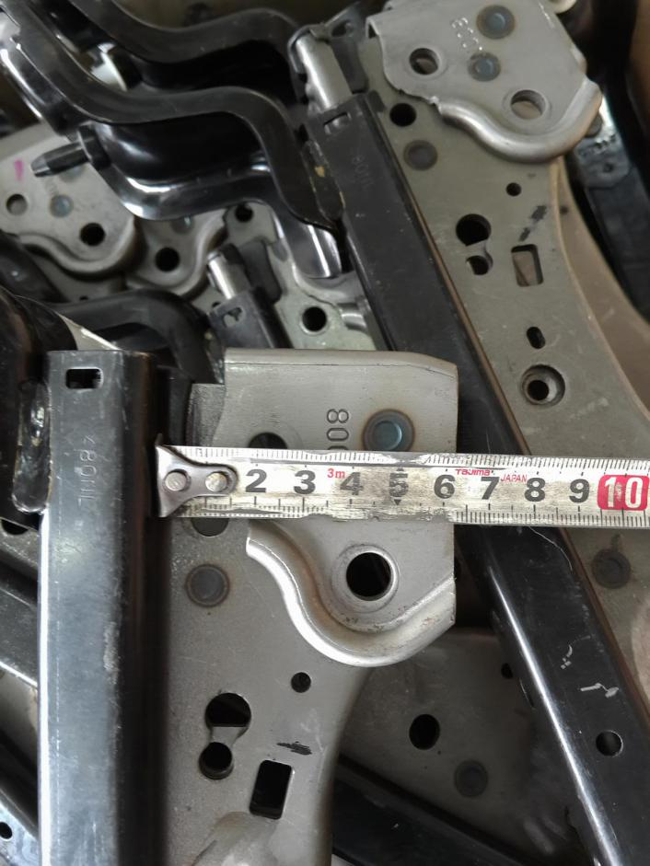
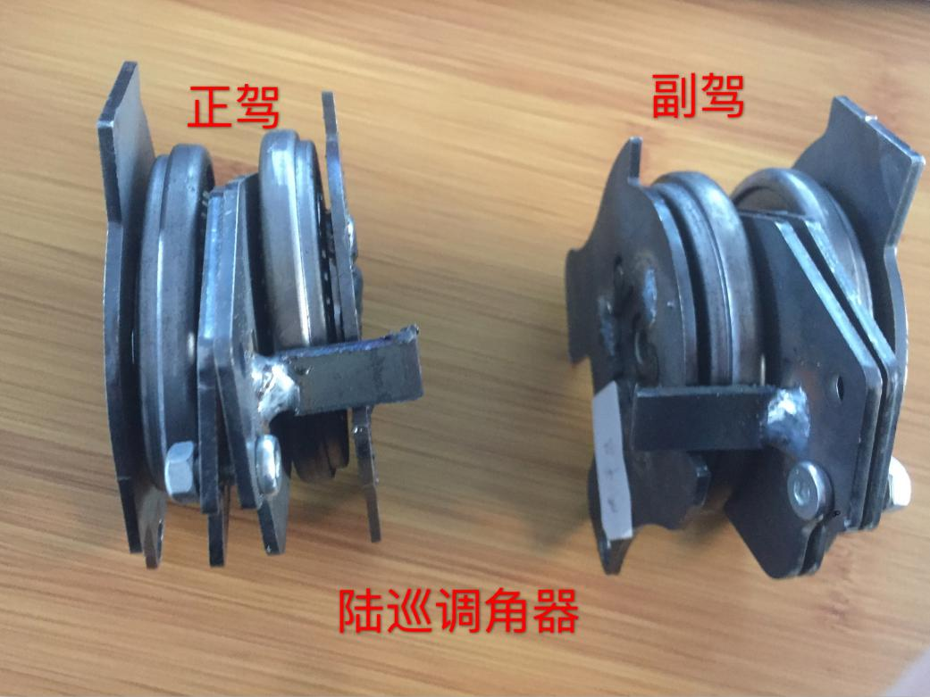
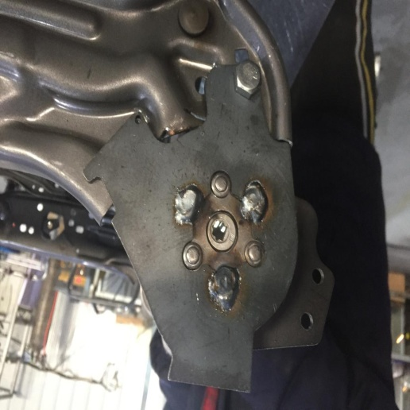
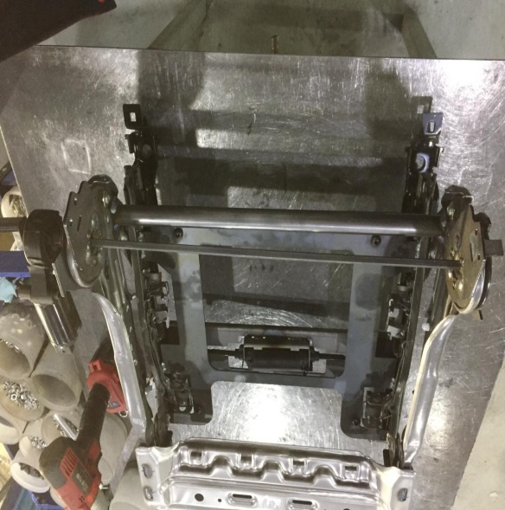
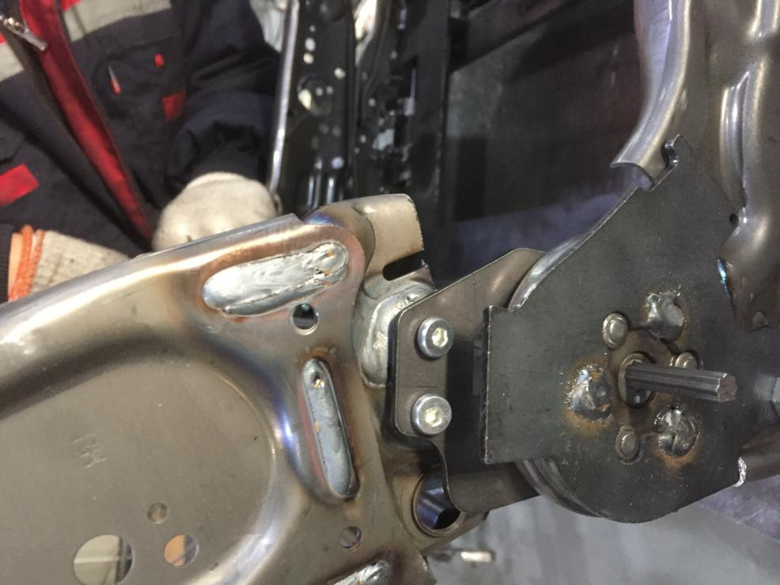
江苏壹贰叁肆汽车科技有限公司
JIANGSU ONE TWO THREE FOUR AUTOMOBILE TECHNOLOGY CO.,LTD
6、调角器焊接 Angle adjuster welding
seat ,and fixed by welding on the baseboard .
Main driving position
Deputy driving position

Slide 9
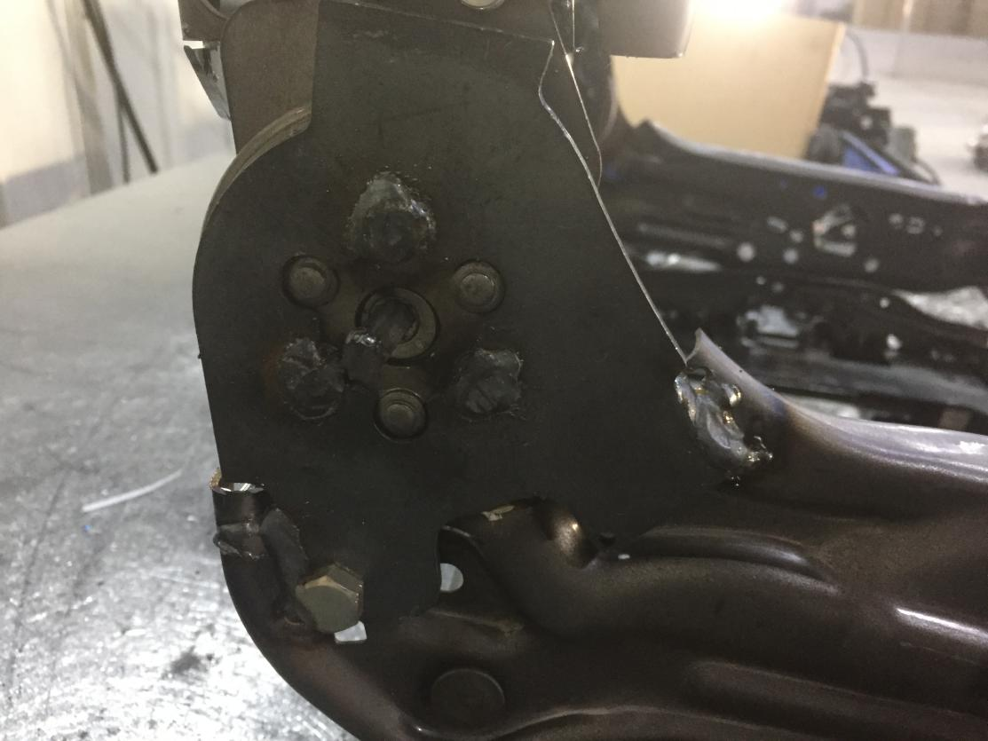
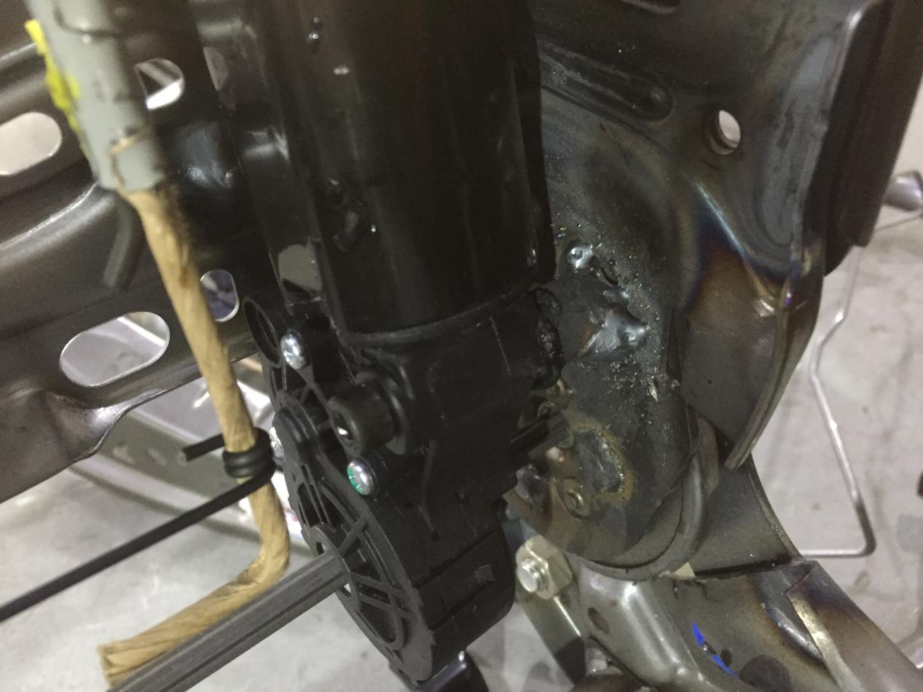
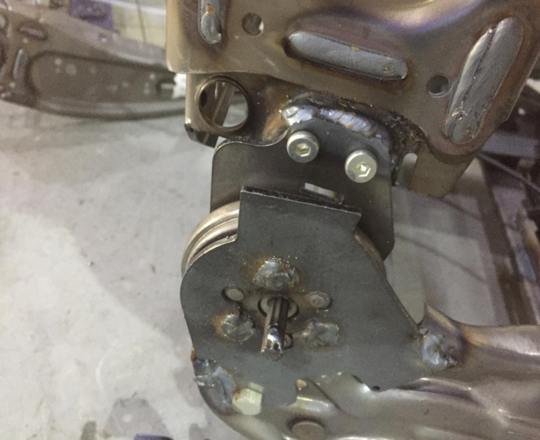
江苏壹贰叁肆汽车科技有限公司
JIANGSU ONE TWO THREE FOUR AUTOMOBILE TECHNOLOGY CO.,LTD
12、按装调角器 Angle adjuster fix

Slide 10
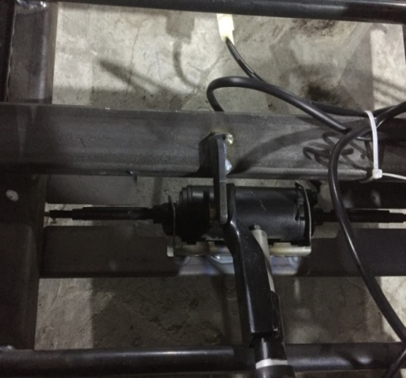
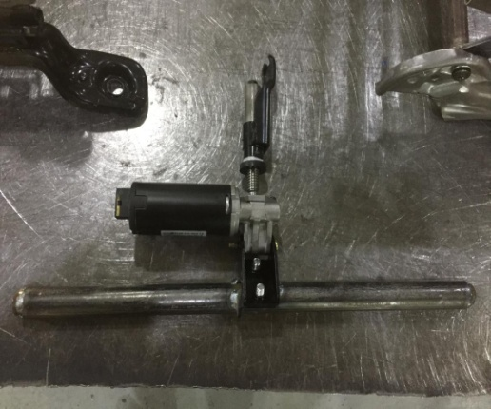
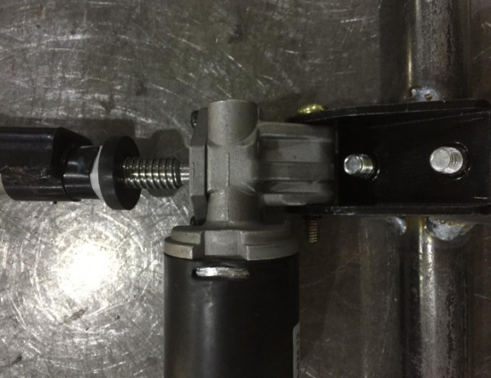
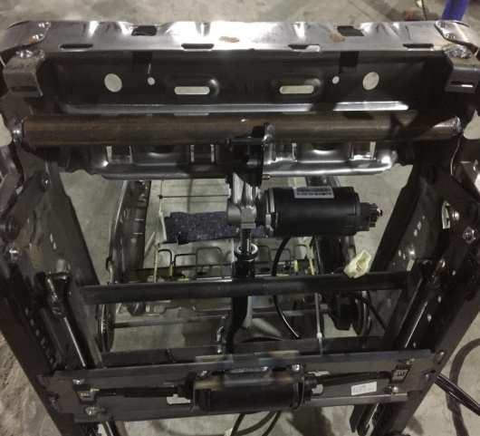
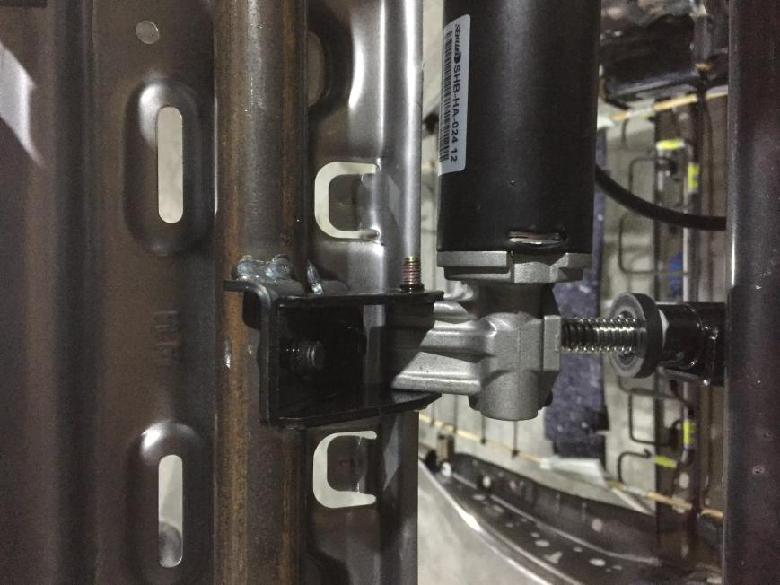
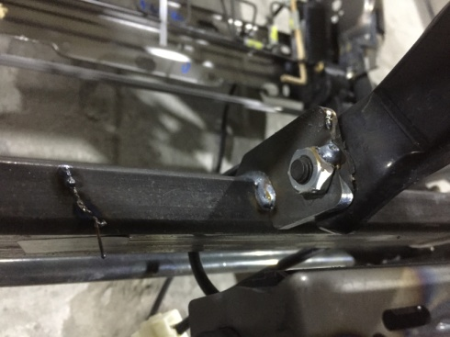
江苏壹贰叁肆汽车科技有限公司
JIANGSU ONE TWO THREE FOUR AUTOMOBILE TECHNOLOGY CO.,LTD
11、安装升降机 Fix elevator

Slide 11
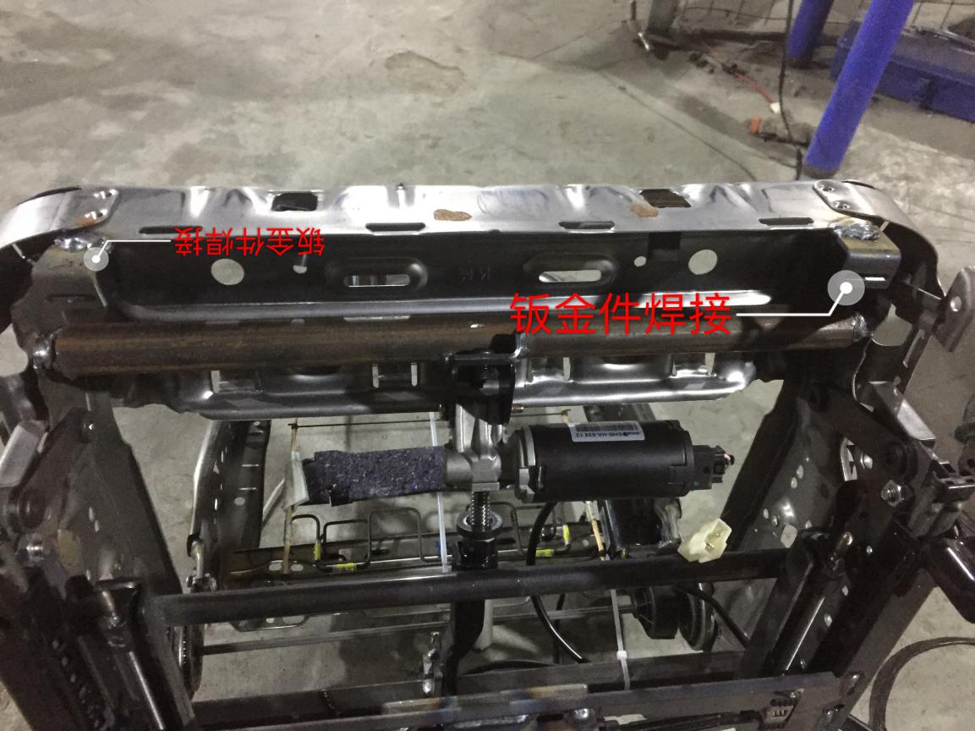
江苏壹贰叁肆汽车科技有限公司
JIANGSU ONE TWO THREE FOUR AUTOMOBILE TECHNOLOGY CO.,LTD
12、焊接原厂金属面板 Weld original metal plate

Slide 12
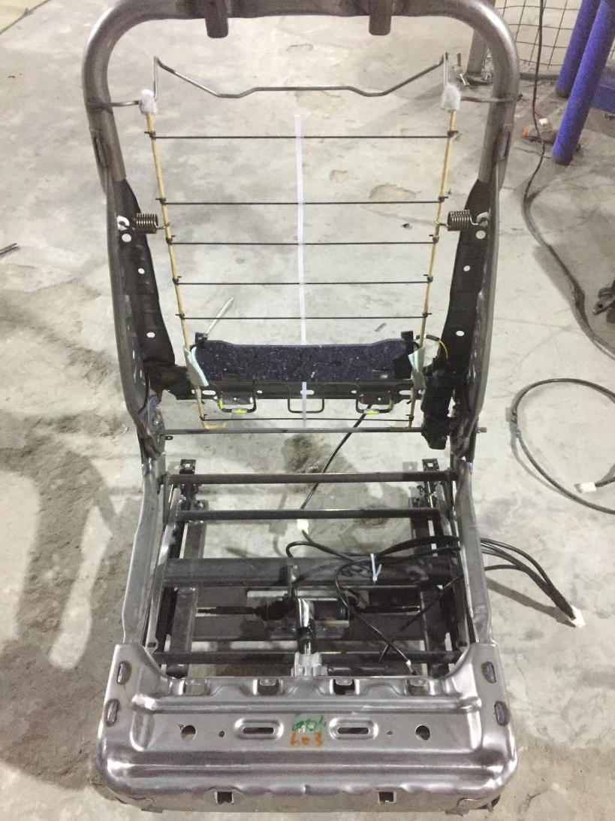
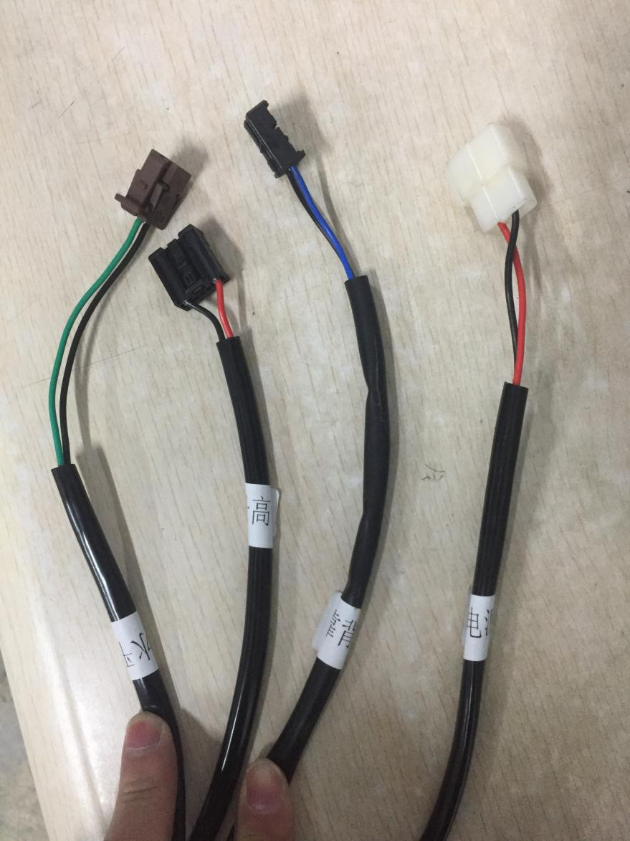
江苏壹贰叁肆汽车科技有限公司
JIANGSU ONE TWO THREE FOUR AUTOMOBILE TECHNOLOGY CO.,LTD
14、安装面板 开关线束 Installing faceplate ,switching on /off cable harness

Slide 13
江苏壹贰叁肆汽车科技有限公司
JIANGSU ONE TWO THREE FOUR AUTOMOBILE TECHNOLOGY CO.,LTD
15、安装面板 开关线束 接电源 安装完毕
installing faceplate ,switching on /off cable harness , connecting power . Completing install.

Slide 14
thank you!
江苏壹贰叁肆汽车科技有限公司
Jiangsu One Two Three Four Auto Technology Co.,Ltd
Contact: 李玲 / Martha
Tel: 0086 18028662668

